Slide 1
Web Advertising
Professor Wei-Min Shen
University of Southern California
Note to other teachers and users of these slides: We would be delighted if you found this our material useful in giving your own lectures. Feel free to use these slides verbatim, or to modify them to fit your own needs. If you make use of a significant portion of these slides in your own lecture, please include this message, or a link to our web site: http://www.mmds.org

Slide 2
OUTLINE
Web Advertising
Definition of Web-Advertising
Greedy algorithm
BALANCE algorithm
Generalized-BALANCE algorithm

Slide 3
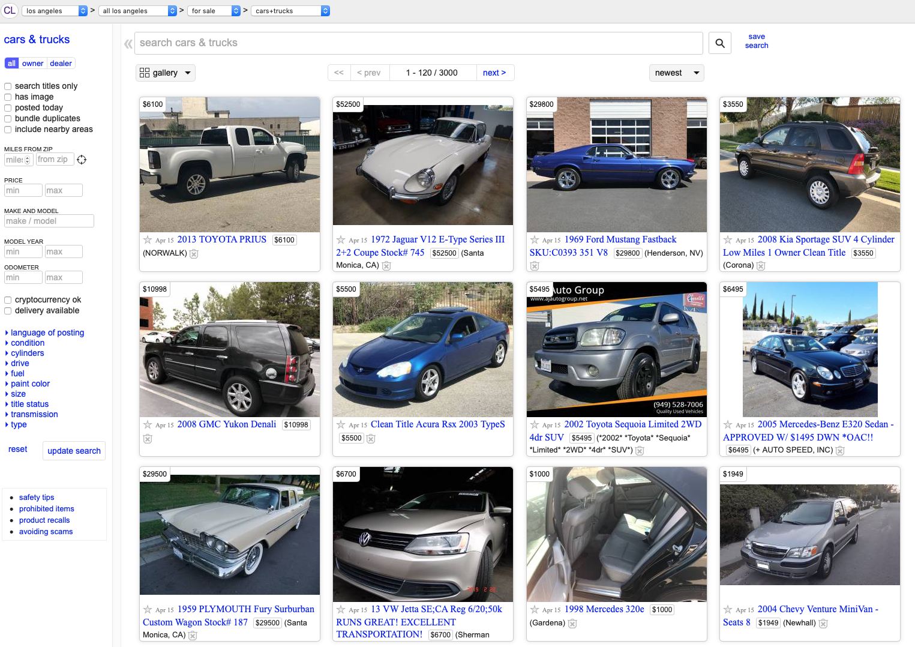
Types of Web Ads
Advertisers post ads directly
Craig’s List, auto trading sites, social networks
Advertisers pay for display ads to be placed on websites
Fixed price per impression (one display of the ad with download of page by a user)
Online stores show ads
Amazon, Macy’s, etc.
Selected by store to maximize probability customer will buy product
Collaborative Filtering
Search ads are placed among results of a search query
Advertisers bid for right to have their ad shown in response to certain queries
Pay only if ad is clicked on

Slide 4
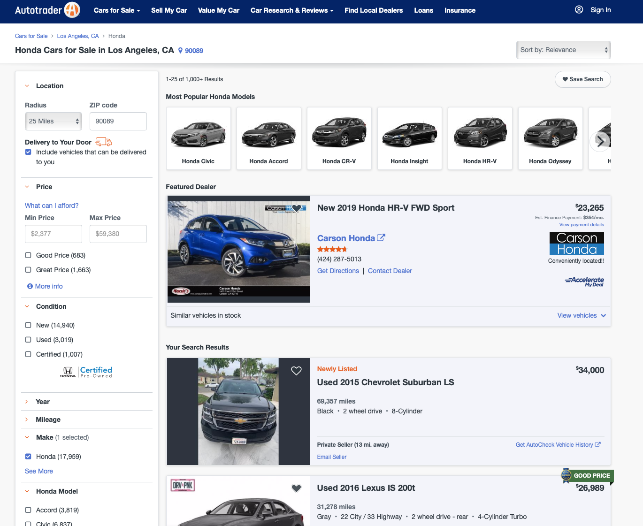
Types of Web Ads
Advertisers pay for display ads to be placed on websites
Often has a fixed price per impression (one display of the ad with download of page by a user)
Online stores show ads
Amazon, Macy’s, etc.
Selected by store to maximize probability customer will buy prod
Collaborative Filtering
Search ads are placed among results of a search query
Advertisers bid for right to have their ad shown in response to certa queries
Pay only if ad is clicked on

Slide 5
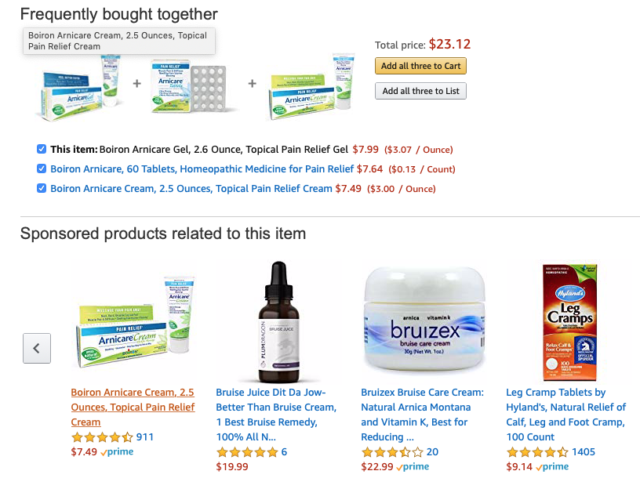

Types of Web Ads
Online stores show ads
Amazon, Macy’s, etc.
Selected by store to maximize probability customer will buy product
Collaborative Filtering

Slide 6
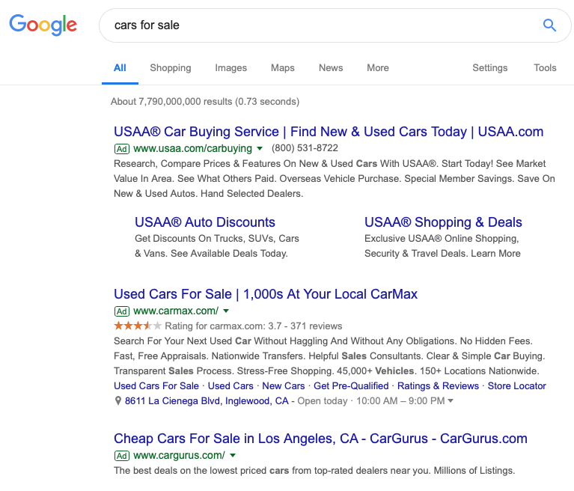

Types of Web Ads: Search Ads

Slide 7
Search Ads Overview
Most lucrative venue for on-line advertising: SEARCH
Impression of an Ad
Ad is displayed
User clicked on the ad link to download the page
Search engine charges advertisers for impression of their ads
Adwords model (Google): matching search queries to advertisements
Require algorithms for optimizing this assignment
Greedy algorithms
Online algorithms
Customer
search
query
Advsr 1
You
impression
Advsr 2
Advsr N

Slide 8
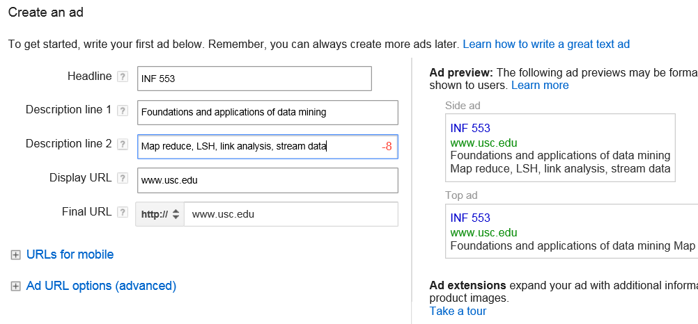
Google AdWords

Slide 9
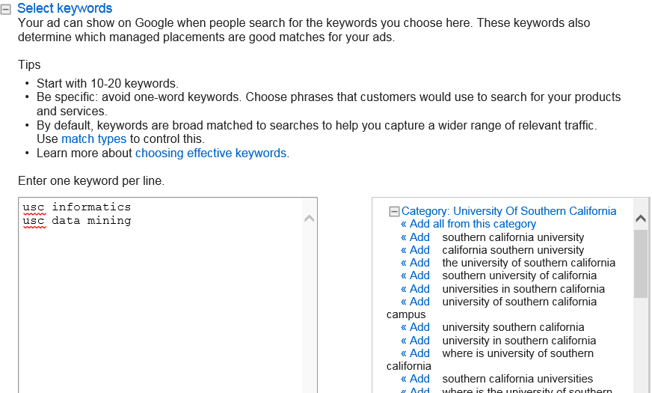
Google AdWords

Slide 10
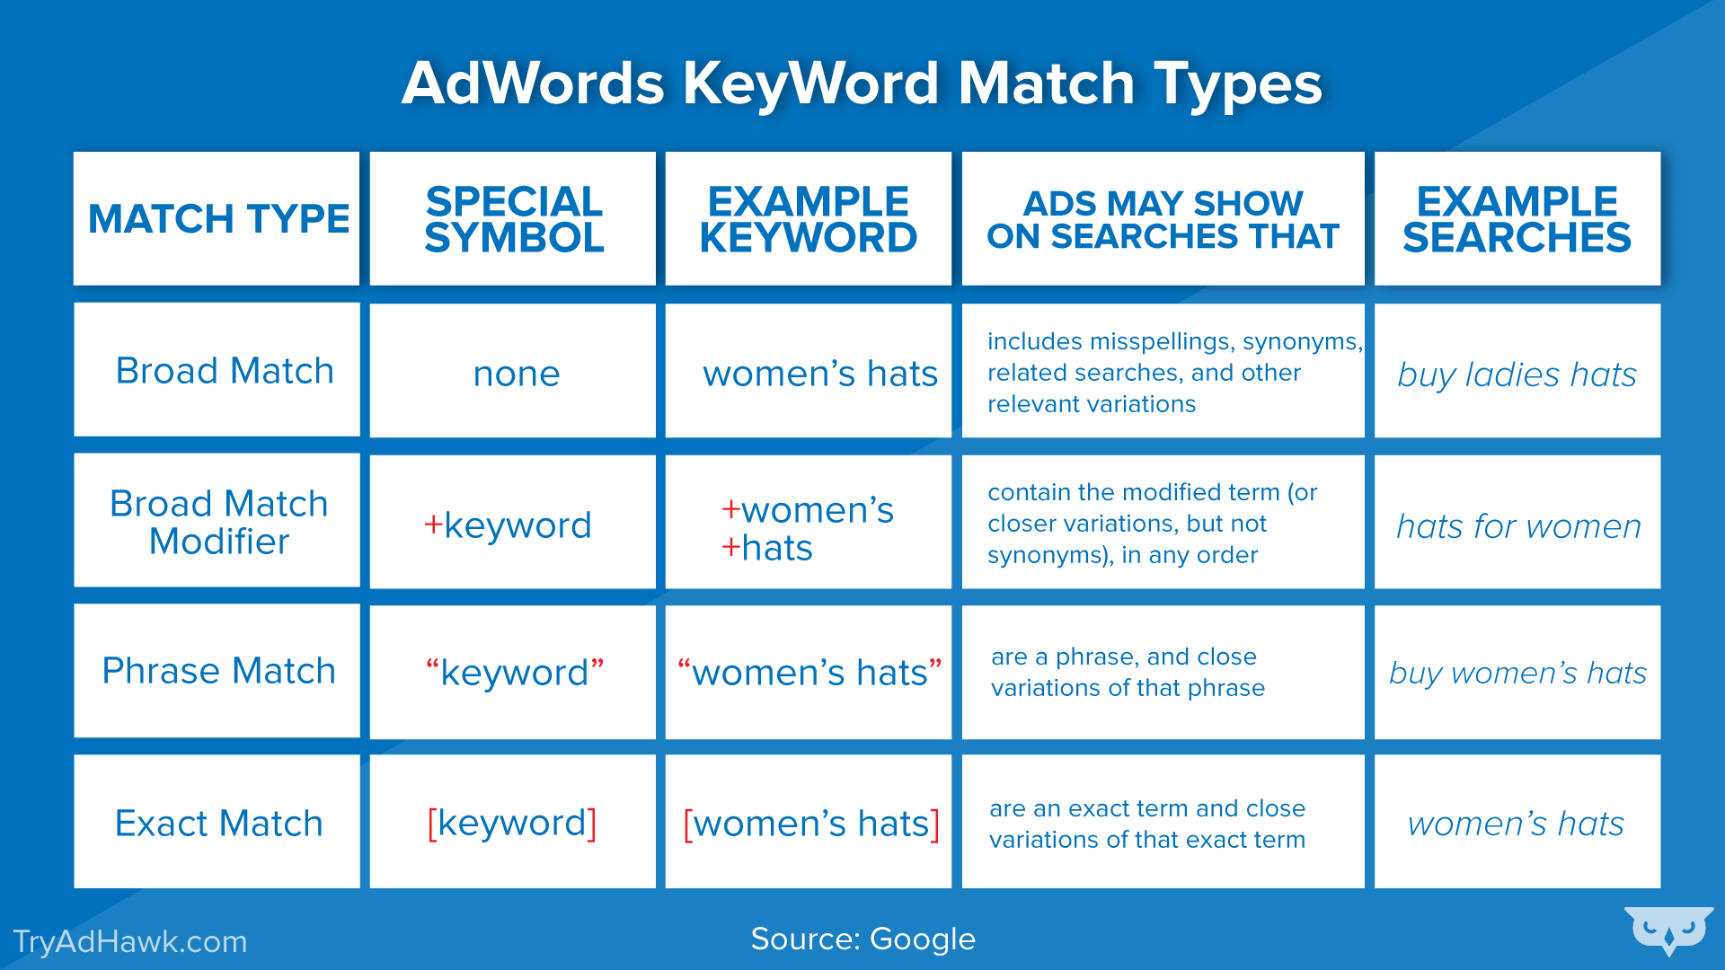
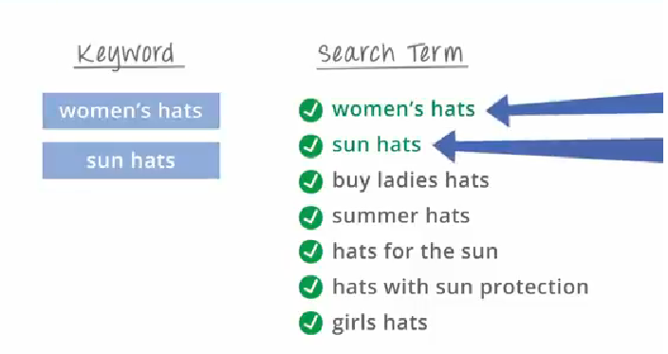
Matching Keywords with Searches
Match types: exact, phrase, broad, negative

Slide 11
Online Algorithms
Customer
Classic model of algorithms
Use the entire input to compute some result
“offline algorithm”
Online Algorithms
You get to see the input one piece at a time, and need to make irrevocable decisions along the way
Make decisions without knowing the future
For search: only know past queries and current query; don’t know what queries will come in later
Similar to handling data streams
An online algorithm cannot always do as well as an offline algorithm
search
query
Advsr 1
You
impression
Advsr 2
Advsr N

Slide 12
Example 8.1
Knowing the future could help
Manufacturer A of conventional furniture
bids 20 cents on both terms “sofa” and “chesterfield”
Manufacturer B of antique furniture
bids 10 cents on search term “chesterfield”
Both have monthly budget of $100
B can place its ad 1,000 times, A can place its ad 500 times
Query “chesterfield” arrives
Can only display one ad
Might display A’s ad because A bid more, but…

Slide 13
Example 8.1
Knowing the future could help
Might display A’s ad because A bid more
20 cents vs 10 cents
However, if there are many queries for “sofa” and few for “chesterfield,” B will never spend its full budget
B only bids on “chesterfield”
Sending “chesterfield” queries to B might increase the overall revenue for you
Without knowing the future, on-line algorithm may not perform as well as offline
Notes:
2018 w1.1

Slide 14
Offline Query-Ad Matching Problem
Advertisers, each
Bids on keywords : “sofa”: 10 cents/impression
Has a budget, e.g., $100/mon
A set of queries in some month, say Sep 2015
e.g., 600 “chesterfield”, 100 “sofa”
Find assignments of queries to bids, such that
Total profit is maximized

Slide 15
Greedy Approach
Consider two furniture manufacturers A and B
A: bids 20 cents on “chesterfield”; 10 cents on “sofa”
B: bids 10 cents on “chesterfield”
Both A and B have budget: $100/month
Queries (expected): 600 “chesterfield”, 100 “sofa”
“chesterfield”: 500 to A => profit: $100
“chesterfield”: 100 to B => profit: $10
=> Total profit: $110

Slide 16
Optimal Solution (for offline)
Consider two furniture manufacturers A and B
A: bids 20 cents on “chesterfield”; 10 cents on “sofa”
B: bids 10 cents on “chesterfield”
Both A and B have budget: $100/mon
Queries (expected): 600 “chesterfield”, 100 “sofa”
Optimal solution: assignment of queries to bids that generates the largest profit
Queries (expected): 600 “chesterfield”, 100 “sofa”
“sofa”: 100 to A => profit: $10
“chesterfield”: 450 to A => profit: $90
“chesterfield”: 150 to B => profit: $15
=> Total profit: $115

Slide 17
Comparison
Bids | Chesterfield | Sofa | Budget
A | 20 cents | 10 cents | $100
B | 10 cents |  | $100
Queries | Chesterfield (600) | Sofa (100) | Profit
A | 500 |  | $100
B | 100 |  | $10
Greedy, Total profit: $110
Queries | Chesterfield (600) | Sofa (100) | Profit
A | 450 | 100 | $100
B | 150 |  | $15
Non-Greedy (Optimal), Total profit: $115

Slide 18
Online Bipartite Matching

Slide 19
The Matching Problem
Simplified version of the problem of matching ads to search queries
Looking for “Maximal matching” in a bipartite graph
involves bipartite graphs with two sets of nodes
All edges connect node on left set to node in right set
1
a
Nodes: Queries and Ads
Goal: Match queries to ads so that maximum number of matchings are made
2
b
3
c
4
d
Ads
Queries

Slide 20
Example: Bipartite Matching
1
a
2
b
3
c
4
d
Ads
Queries
M = {(1,a),(2,b),(3,d)} is a matching
Cardinality of matching = |M| = 3

Slide 21
Example: Bipartite Matching
1
a
2
b
3
c
4
d
Ads
Queries
M = {(1,c),(2,b),(3,d),(4,a)} is a perfect matching
Maximal matching: a matching that contains the largest possible number of matches
Perfect matching: all vertices of the graph are matched

Slide 22
Matching Algorithm
Problem: Find a maximal matching for a given bipartite graph
A perfect one if it exists
There is a polynomial-time offline algorithm based on augmenting paths
Hopcroft & Karp 1973, see http://en.wikipedia.org/wiki/Hopcroft-Karp_algorithm
But what if we do not know the entire graph upfront?

Slide 23
Online Graph Matching Problem
Initially, we are given the set ads
In each round, one set of query terms is added
Relevant edges are revealed
Indicate which advertisers have bid on those query terms
At that time, we have to decide to either:
Pair the query with an ad
Do not pair the query with any ad
1
a
2
b
3
c
4
d
(1,a)
(2,b)
(3,d)

Slide 24
Greedy Algorithm
Greedy algorithm for the online graph matching problem:
Pair the new query with any eligible ad
If there is none, do not pair query
How good is the algorithm?

Slide 25
Competitive Ratio
For input I, suppose greedy produces matching M_{greedy} while an optimal matching is M_{opt}
Competitive ratio =
min_{all possible inputs I} (|M_{greedy}| / |M_{opt}|)
greedy’s worst performance over all possible inputs I

Slide 26
Analyzing the Greedy Algorithm
Consider a case: M_{greedy}≠ M_{opt}
Consider the set Q of queries (“wasted”) matched in M_{opt} but not in M_{greedy}
A is the set of ads that are linked
to a non-matched query in Q, and A
(“blocking”) already matched in M_{greedy}
If there exists such a non-matched (by M_{greedy}) ad linked to a non-matched query, then greedy would have matched them
Since ads A are already matched in M_{greedy} then (1) |M_{greedy}|≥ |A|
M_{opt}
1
a
M_{greedy}
2
b
3
c
4
d
A={ }
Q={ }
Notes:
2019 w1.1

Slide 27
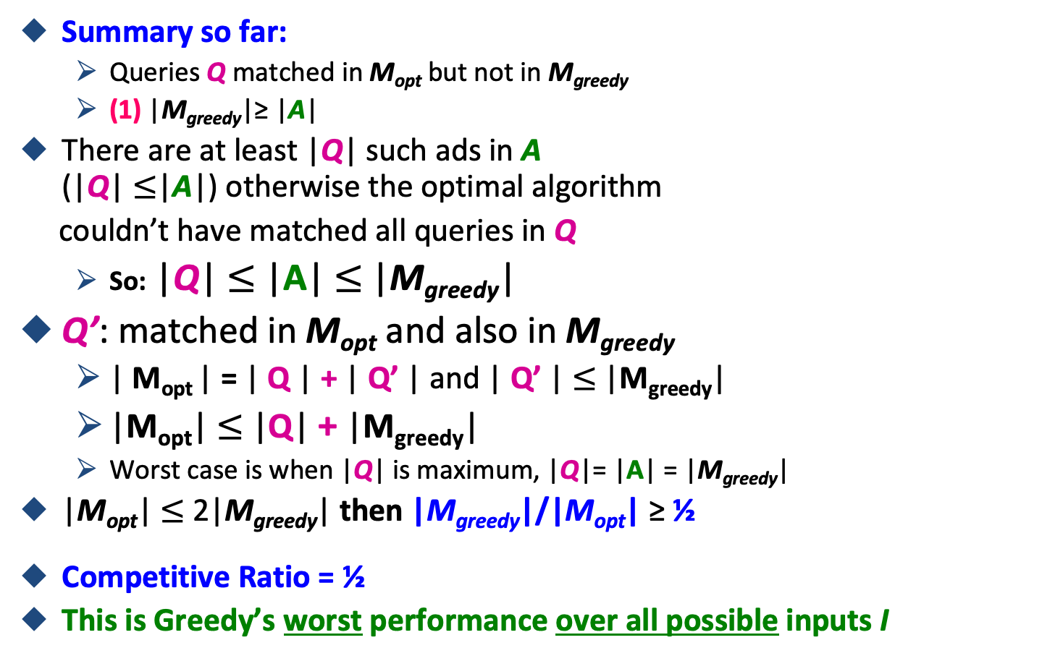
Analyzing the Greedy Algorithm
M_{opt}
1
a
M_{greedy}
2
b
3
c
4
d
A={ }
Q={ }
Notes:
This is a general proof.
We make no assumptions about the structure of the bipartite graph.

Slide 28
Worst-case Scenario
1
a
(1,a)
2
b
(2,b)
3
c
4
d
Worst case is when |Q| = |A| = |M_{greedy}|
Q = {c,d} – queries with no matching ad
A = {1,2} – ads that are adjacent to a query in Q but are already matched to another query
|M_{greedy}| = 2, |Q| = 2, |A| = 2
Optimal matching: (1,c), (2,d), (3,b), (4,a)
|M_{opt}| = 4
|M_{greedy}|/|M_{opt}| = ½ (competitive ratio)

Slide 29
“Performance-Based” Web Advertising
“Showing is not enough,
must be clicked”
Notes:
20170101

Slide 30
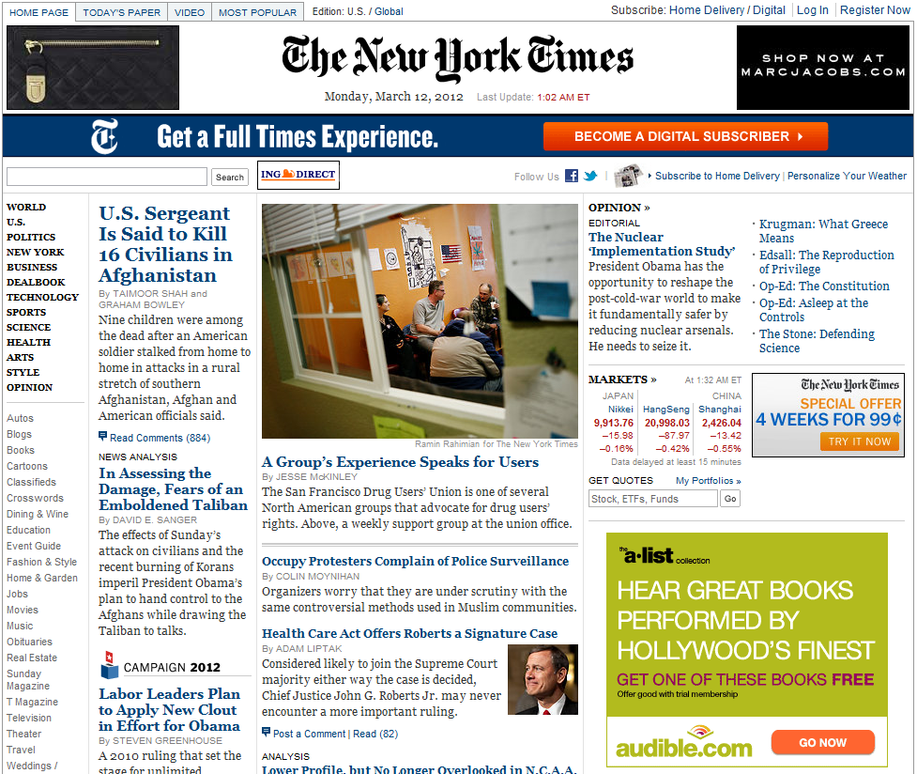
History of Web Advertising
Banner ads (1995-2001)
Initial form of web advertising
Popular websites charged $X for every 1,000 “impressions” of the ad
Called “CPM” rate (Cost per thousand impressions)
Modeled similar to TV, magazine ads
From untargeted to demographically targeted
Low click-through rates
Low Return on Investment (ROI) for advertisers
CPM…cost per mille
Mille…thousand in Latin

Slide 31
Performance-based Advertising
Introduced by Overture around 2000
Advertisers bid on search keywords
When someone searches for that keyword, the highest bidder’s ad is shown first
Advertiser is charged only if the ad is *clicked* on
Similar model adopted by Google with some changes around 2002
Called Adwords

Slide 32
Web 2.0
Performance-based advertising works!
Multi-billion-dollar industry
Interesting problem: What ads to show for a given query?
(Today’s lecture)
If I am an advertiser, which search terms should I bid on and how much should I bid?
(Not focus of today’s lecture)

Slide 33
Adwords Problem
Given:
1. A set of bids by advertisers for search queries
2. A click-through rate (CTR) for each advertiser-query pair
3. A budget for each advertiser (say for 1 month)
4. A limit on the number of ads to be displayed with each search query
Respond to each search query with a set of advertisers such that:
1. The size of the set is no larger than the limit on the number of ads per query
2. Each advertiser has bid on the search query
3. Each advertiser has enough budget left to pay for the ad if it is clicked upon

Slide 34
Adwords Problem
A stream of queries arrives at the search engine: q₁, q₂, …
Several advertisers bid on each query
When query q_{i} arrives, search engine must pick a subset of advertisers whose ads are shown
Goal: Maximize search engine’s revenues
Simple solution: Instead of raw bids, use the “expected revenue per click” (i.e., Bid*CTR)
Clearly we need an online algorithm!

Slide 35
The Adwords Innovation
Advertiser
Bid
CTR
Bid * CTR
A
$1.00
1%
1 cent
B
$0.75
2%
1.5 cents
C
$0.50
2.5%
1.125 cents
Click through rate
Expected revenue

Slide 36
The Adwords Innovation
Advertiser
Bid
CTR
Bid * CTR
B
$0.75
2%
1.5 cents
C
$0.50
2.5%
1.125 cents
A
$1.00
1%
1 cent

Slide 37
Complications: Budget
Two complications:
Budget
Click-through rate (CTR) of an ad is unknown
Each advertiser has a limited budget
Search engine guarantees that the advertiser will not be charged more than their daily or monthly budget

Slide 38
Complications: CTR
CTR: Each ad has a different likelihood of being clicked
Advertiser 1 bids $2, click probability = 0.1
Advertiser 2 bids $1, click probability = 0.5
Click-through rate (CTR) is measured historically
Very hard problem: Exploration vs. exploitation Exploit: Should we keep showing an ad for which we have good estimates of click-through rate or Explore: Shall we show a brand new ad to get a better sense of its click-through rate

Slide 39
Greedy Algorithm
Our setting: Simplified environment
There is 1 ad shown for each query
All advertisers have the same budget B
All ads are equally likely to be clicked
Value of each ad is the same (=1)
Simplest algorithm is greedy:
For a query pick any advertiser who has bid 1 for that query
Competitive ratio of greedy is 1/2
1
a
2
b
3
c
4
d

Slide 40
Bad Scenario for Greedy
Two advertisers A and B
A bids on query x, and B bids on x and y
Both have budgets of $4
Query stream: x x x x y y y y
Worst case greedy choice: B B B B _ _ _ _
Optimal: A A A A B B B B
Competitive ratio = ½
This is the worst case!
Note: Greedy algorithm is deterministic – it always resolves draws in the same way
Notes:
Is greedy deterministic or randomized (it is deterministic!!)
given a particular input, will always produce the same output,

Slide 41
Greedy algorithm with non-equal bids
Greedy algorithm would assign the query to the highest bidder who still has budget left

Slide 42
Greedy Example: Two advertisers bid on a query q
Bidder A₁: bid x₁ = 20 budget b₁ = 40
Bidder A₂: bid x₂ = 10 budget b₂ = 50
Assume ties are broken in favor of A₁
Query q | Assigned to Bidder (A₁, A₂ or No Ad) | Remaining Budget for A₁ | Remaining Budget for A₂
At start | ---- | 40 | 50
1st query q
2nd query q
3rd query q
4th query q
5th query q
6th query q
7th query q
8th query q

Slide 43
Greedy Example: Two advertisers bid on a query q
Bidder A₁: bid x₁ = 20 budget b₁ = 40
Bidder A₂: bid x₂ = 10 budget b₂ = 50
Assume ties are broken in favor of A₁
Query q | Assigned to Bidder (A₁, A₂ or No Ad) | Remaining Budget for A₁ | Remaining Budget for A₂
At start | ---- | 40 | 50
1st query q | A1 | 20 | 50
2nd query q
3rd query q
4th query q
5th query q
6th query q
7th query q
8th query q

Slide 44
Greedy Example: Two advertisers bid on a query q
Bidder A₁: bid x₁ = 20 budget b₁ = 40
Bidder A₂: bid x₂ = 10 budget b₂ = 50
Assume ties are broken in favor of A₁
Query q | Assigned to Bidder (A₁, A₂ or No Ad) | Remaining Budget for A₁ | Remaining Budget for A₂
At start | ---- | 40 | 50
1st query q | A1 | 20 | 50
2nd query q | A1 | 0 | 50
3rd query q
4th query q
5th query q
6th query q
7th query q
8th query q

Slide 45
Greedy Example: Two advertisers bid on a query q
Bidder A₁: bid x₁ = 20 budget b₁ = 40
Bidder A₂: bid x₂ = 10 budget b₂ = 50
Assume ties are broken in favor of A₁
Query q | Assigned to Bidder (A₁, A₂ or No Ad) | Remaining Budget for A₁ | Remaining Budget for A₂
At start | ---- | 40 | 50
1st query q | A1 | 20 | 50
2nd query q | A1 | 0 | 50
3rd query q | A2 | 0 | 40
4th query q
5th query q
6th query q
7th query q
8th query q

Slide 46
Greedy Example: Two advertisers bid on a query q
Bidder A₁: bid x₁ = 20 budget b₁ = 40
Bidder A₂: bid x₂ = 10 budget b₂ = 50
Assume ties are broken in favor of A₁
Query q | Assigned to Bidder (A₁, A₂ or No Ad) | Remaining Budget for A₁ | Remaining Budget for A₂
At start | ---- | 40 | 50
1st query q | A1 | 20 | 50
2nd query q | A1 | 0 | 50
3rd query q | A2 | 0 | 40
4th query q | A2 | 0 | 30
5th query q | A2 | 0 | 20
6th query q | A2 | 0 | 10
7th query q | A2 | 0 | 0
8th query q | No ad | 0 | 0

Slide 47
BALANCE Algorithm [MSVV]
BALANCE Algorithm by Mehta, Saberi, Vazirani, and Vazirani
For each query, pick the advertiser with the largest unspent budget
Break ties arbitrarily (but in a deterministic way)
BALANCE: Prefer the bidder who has the deepest pocket,
not who pays the most ☺

Slide 48
Example: BALANCE
Two advertisers A and B
A bids on query x, and B bids on x and y
Both have budgets of $4
Query stream: x x x x y y y y
BALANCE choice: A B A B B B _ _
Optimal: A A A A B B B B
In general: For BALANCE on 2 advertisers Competitive ratio = ¾

Slide 49
BALANCE Example: Two advertisers bid on a query q
Bidder A₁: bid x₁ = 20 budget b₁ = 40
Bidder A₂: bid x₂ = 10 budget b₂ = 50
Assume ties are broken in favor of A₁
Query q | Assigned to Bidder (A₁, A₂ or No Ad) | Remaining Budget for A₁ | Remaining Budget for A₂
At start | ---- | 40 | 50
1st query q
2nd query q
3rd query q
4th query q
5th query q
6th query q
7th query q
8th query q

Slide 50
BALANCE Example: Two advertisers bid on a query q
Bidder A₁: bid x₁ = 20 budget b₁ = 40
Bidder A₂: bid x₂ = 10 budget b₂ = 50
Assume ties are broken in favor of A₁
Query q | Assigned to Bidder (A₁, A₂ or No Ad) | Remaining Budget for A₁ | Remaining Budget for A₂
At start | ---- | 40 | 50
1st query q | A2 | 40 | 40
2nd query q
3rd query q
4th query q
5th query q
6th query q
7th query q
8th query q

Slide 51
BALANCE Example: Two advertisers bid on a query q
Bidder A₁: bid x₁ = 20 budget b₁ = 40
Bidder A₂: bid x₂ = 10 budget b₂ = 50
Assume ties are broken in favor of A₁
Query q | Assigned to Bidder (A₁, A₂ or No Ad) | Remaining Budget for A₁ | Remaining Budget for A₂
At start | ---- | 40 | 50
1st query q | A2 | 40 | 40
2nd query q | A1 | 20 | 40
3rd query q
4th query q
5th query q
6th query q
7th query q
8th query q

Slide 52
BALANCE Example: Two advertisers bid on a query q
Bidder A₁: bid x₁ = 20 budget b₁ = 40
Bidder A₂: bid x₂ = 10 budget b₂ = 50
Assume ties are broken in favor of A₁
Query q | Assigned to Bidder (A₁, A₂ or No Ad) | Remaining Budget for A₁ | Remaining Budget for A₂
At start | ---- | 40 | 50
1st query q | A2 | 40 | 40
2nd query q | A1 | 20 | 40
3rd query q | A2 | 20 | 30
4th query q
5th query q
6th query q
7th query q
8th query q

Slide 53
BALANCE Example: Two advertisers bid on a query q
Bidder A₁: bid x₁ = 20 budget b₁ = 40
Bidder A₂: bid x₂ = 10 budget b₂ = 50
Assume ties are broken in favor of A₁
Query q | Assigned to Bidder (A₁, A₂ or No Ad) | Remaining Budget for A₁ | Remaining Budget for A₂
At start | ---- | 40 | 50
1st query q | A2 | 40 | 40
2nd query q | A1 | 20 | 40
3rd query q | A2 | 20 | 30
4th query q | A2 | 20 | 20
5th query q
6th query q
7th query q
8th query q

Slide 54
BALANCE Example: Two advertisers bid on a query q
Bidder A₁: bid x₁ = 20 budget b₁ = 40
Bidder A₂: bid x₂ = 10 budget b₂ = 50
Assume ties are broken in favor of A₁
Query q | Assigned to Bidder (A₁, A₂ or No Ad) | Remaining Budget for A₁ | Remaining Budget for A₂
At start | ---- | 40 | 50
1st query q | A2 | 40 | 40
2nd query q | A1 | 20 | 40
3rd query q | A2 | 20 | 30
4th query q | A2 | 20 | 20
5th query q | A1 | 0 | 20
6th query q
7th query q
8th query q

Slide 55
BALANCE Example: Two advertisers bid on a query q
Bidder A₁: bid x₁ = 20 budget b₁ = 40
Bidder A₂: bid x₂ = 10 budget b₂ = 50
Assume ties are broken in favor of A₁
Query q | Assigned to Bidder (A₁, A₂ or No Ad) | Remaining Budget for A₁ | Remaining Budget for A₂
At start | ---- | 40 | 50
1st query q | A2 | 40 | 40
2nd query q | A1 | 20 | 40
3rd query q | A2 | 20 | 30
4th query q | A2 | 20 | 20
5th query q | A1 | 0 | 20
6th query q | A2 | 0 | 10
7th query q
8th query q

Slide 56
BALANCE Example: Two advertisers bid on a query q
Bidder A₁: bid x₁ = 20 budget b₁ = 40
Bidder A₂: bid x₂ = 10 budget b₂ = 50
Assume ties are broken in favor of A₁
Query q | Assigned to Bidder (A₁, A₂ or No Ad) | Remaining Budget for A₁ | Remaining Budget for A₂
At start | ---- | 40 | 50
1st query q | A2 | 40 | 40
2nd query q | A1 | 20 | 40
3rd query q | A2 | 20 | 30
4th query q | A2 | 20 | 20
5th query q | A1 | 0 | 20
6th query q | A2 | 0 | 10
7th query q | A2 | 0 | 0
8th query q | No Ad | 0 | 0

Slide 57
Analyzing BALANCE
Consider simple case (w.l.o.g.):
2 advertisers, A₁ and A₂, each with budget B (≥1)
Optimal solution exhausts both advertisers’ budgets
BALANCE must exhaust at least one advertiser’s budget:
Because optimal exhausts both
If not, we can allocate more queries
Whenever both advertisers bid on the query, chosen advertiser’s unspent budget only decreases
Assume BALANCE exhausts A₂’s budget, but allocates x queries fewer than the optimal
Revenue: BAL = 2B - x
Notes:
Why exhausts budget:
-- remember, optimal exhausts both budgets
GENERAL PROOF

Slide 58
Analyzing Balance
Queries allocated to A₁ in the optimal solution
B
Queries allocated to A₂ in the optimal solution
Optimal revenue = 2B
Balance Algorithm:
Assume Balance gives revenue = 2B-x or B+y
A₁
A₂
x
B
Unassigned queries can only be assigned to A₂
(if we could assign to A₁ we would, since we still have budget)
Goal: Show we have y ≥ x
Case 1) ≤ ½ of A₁’s queries got assigned to A₂ then y >= B/2, so y >= x (y+x = B)
y
x
A₁
Not used
A₂
BALANCE exhausts A₂’s budget
Notes:
Whatever is not used should be assigned to A2 (since if we could assign to A1 we would since we still have the budget)
CASE 1) Less than half of A1’s queries got assigned to A2. So y>B/2
CASE 2) If more than half of A1’s queries got assigned to A2.
Consider last of A1s queries assigned to A2. At that time B2 > B1 since balance chose A2
Since more than half of the B queries that the optimum algorithm assigns to A1 are assigned to A2 by balance, the remaining budget of A2 was less than B/2
And remaining budget of A1 is also < B/2
Budgets only decrease so x < B/2
Since x + y = B, y>= x
Since more than half of the B queries that
the optimum algorithm assigns to A1 are assigned to A2 by Balance, we
know that when q was assigned, the remaining budget of A2 was less than
B/ 2.

Slide 59
Analyzing Balance
B1
x
Queries allocated to A₁ in the optimal solution
B
Queries allocated to A₂ in the optimal solution
y
x
Optimal revenue = 2B
Balance Algorithm:
Assume Balance gives revenue = 2B-x or B+y
A₁
A₂
Not used
Unassigned queries can only be assigned to A₂
Goal: Show we have y ≥ x
Case 2) > ½ of A₁’s queries got assigned to A₂, consider last of A₁’s queries assigned to A₂:
B2 >= B1 since Balance chose A₂
B2 <= B/2 (since at least ½ of A₁’s queries got assigned to A₂)
Thus, B1<=B2 <= B/2, so x (or B1) < B/2, and x + y = B -> y >= x
Balance revenue is minimum for x=y=B/2 (i.e., Max x = B/2)
Minimum Balance revenue = 3B/2
Competitive Ratio = 3/4 // [3B/2] / 2B = 3/4
Notes:
Whatever is not used should be assigned to A2 (since if we could assign to A1 we would since we still have the budget)
CASE 1) Less than half of A1’s queries got assigned to A2. So y>B/2
CASE 2) If more than half of A1’s queries got assigned to A2.
Consider the last of A1s queries assigned to A2. At that time B2 > B1 since balance chose A2.
Since more than half of the B queries that the optimum algorithm assigns to A1 are assigned to A2 by balance, the remaining budget of A2 was less than B/2
And remaining budget of A1 is also < B/2
Budgets only decrease so x < B/2
Since x + y = B, y>= x
Since more than half of the B queries that
the optimum algorithm assigns to A1 are assigned to A2 by Balance, we
know that when q was assigned, the remaining budget of A2 was less than
B/ 2.

Slide 60
BALANCE: General Result
For Balance algorithm with many bidders
In the general case, worst competitive ratio of BALANCE is 1–1/e = approx. 0.63
Interestingly, no online algorithm has a better competitive ratio!
Let’s see the worst case example that gives this ratio
Notes:
2018 summer w2.1

Slide 61
Worst case for BALANCE
Kalyanasundaram, B., & Pruhs, K. R. (2000). An optimal deterministic algorithm for online b-matching. Theoretical Computer Science, 233(1-2), 319-325.
N advertisers: A₁ , A₂ , … A_{i} ,… A_{N}
Each has a budget B = i // budgets are 1,2,3,…, N
Queries:
N∙B queries appear in N rounds of B queries each
Bidding (requirement or qualification):
Round 1 queries can be bid by A₁, A₂, …, …, A_{N}
Round 2 queries can be bid by A₂, A₃, …, …, A_{N}
Round i queries can be bid by A_{i}, …, A_{N}
Optimum allocation: // from front to back Allocate round i queries to A_{i} // even though there are other bidders
Optimum revenue N∙B = 1+2+3+…+N
BALANCE: // from back to front
Assigns query in round 1 to N advertisers equally, since all can bid on q1
But prefer/select the bidder with the largest remaining budget, e.g., A_{N}
For q2, only A₂, A₃, …, A_{N} can bid, so still prefer the larger bidders;
For each query qi, only A_{i}, …, A_{N} still prefer the back bidders
Round 1 has 1 queries
Round 2 has 2 queries
Round 3 has 3 queries
…
Round i has i queries
…
Round N has N queries

Slide 62
BALANCE Allocation
…
B/(N-2)
B/(N-1)
B/N
A₁
A₂
A₃
A_{N-1}
A_{N}
Eventually, budgets of higher-numbered advertisers exhausted
j is approximate value where all advertisers are out of budget or cannot bid on the remaining queries
Each round has revenue B so the approx. total revenue is B x j = BN(1-1/e)
1+1/2+…+1/n
1+1/2+…+1/(n-j)
…
1/(n-j+1)+…+1/n
Notes:
Each round has revenue B so the approx. total revenue is B x j = BN(1-1/e)
1+1/2+…+1/n
1+1/2+…+1/(n-j)
1/(n-j+1)+…+1/n
2018 1.2

Slide 63
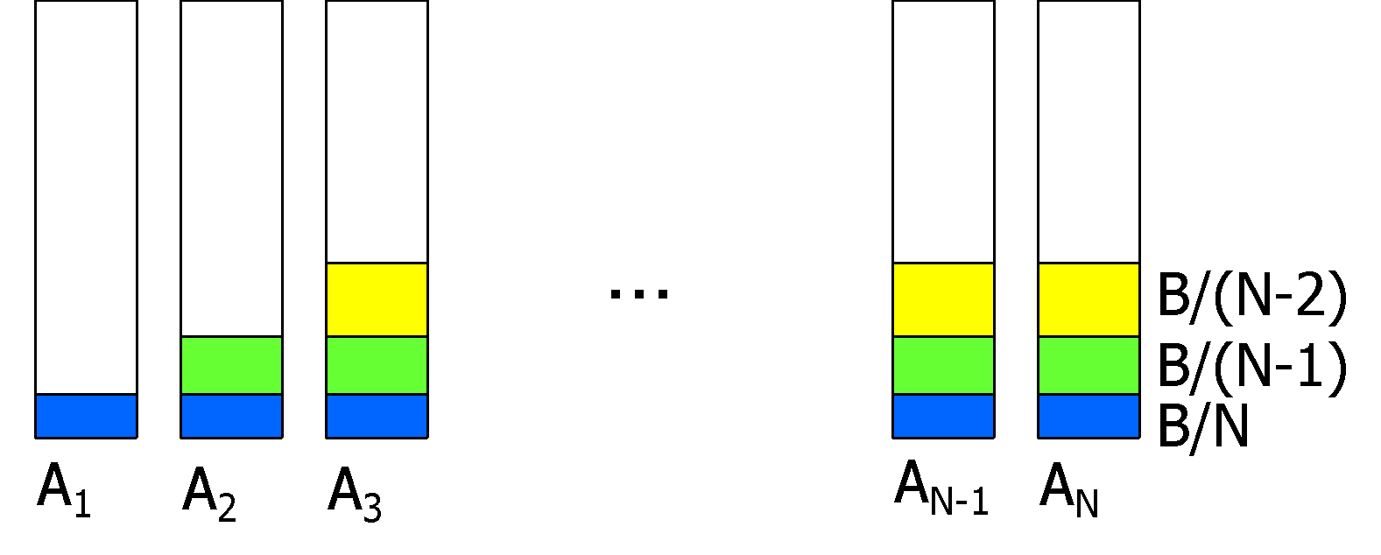
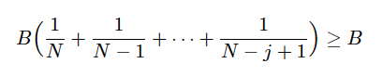


BALANCE Allocation
Eventually, budgets of higher-numbered advertisers exhausted
j is approximate value where all advertisers are out of budget or do not bid on remaining queries
Last round, the last bidder used up all its budget, B:
So we want j such that ln(N) - ln(N-j) = 1 (approximately)
j = N(1-1/e) -> Each round has revenue B so the approx. total revenue is B x j
Approximate revenue of Balance Algorithm is BN(1-1/e)
Competitive ratio is 1-1/e
(1+1/2+…+1/n) - (1+1/2+…+1/(n-j)) = 1/(n-j+1)+…+1/n
Notes:
Each round has revenue B so the approx. total revenue is B x j = BN(1-1/e)
1+1/2+…+1/n
1+1/2+…+1/(n-j)
≈
2018 1.2

Slide 64
General Version of the Problem
Kalyanasundaram, B., & Pruhs, K. R. (2000). An optimal deterministic algorithm for online b-matching. Theoretical Computer Science, 233(1-2), 319-325.
Balance works well when bids are 1,0
In practice, bids and budgets can be arbitrary
In a general setting, BALANCE can perform poorly
Example 8.9: Consider two advertisers A₁ and A₂
A₁: bid₁ = 1, budget₁ = 110
A₂: bid₂ = 10, budget₂ = 100
Consider: we see 10 instances of q
BALANCE always selects A₁ because it has largest remaining budget
Earns total revenue = 10
Favors advertiser with larger remaining budget
Optimal earns 100

Slide 65
Modifications Needed to BALANCE Algorithm
Bias choice of ad in favor of higher bids
Consider the fraction of budget remaining, so we bias toward using some of each advertiser’s budget
More “risk averse”: don’t leave too much of any advertiser’s budget unused

Slide 66
Generalized BALANCE Algorithm
Arbitrary bids: consider query q, bidder i
Bid = x_{i}
Budget = b_{i}
Amount spent so far = m_{i}
Fraction of budget left over f_{i} = 1- (m_{i}/b_{i})
Define ψ_{i}(q) = x_{i} * (1-e^{-fi}) ψ (psi)
bid * (1-e^{-(fraction of budget left)})
Allocate query q to bidder i with largest value of ψ_{i}(q)
Same competitive ratio (1-1/e)
Notes:
Psi

Slide 67
Example 8.10
Bidder A₁: x₁ = 1, b₁ = 110
Bidder A₂: x₂ = 10, b₂ = 100
First occurrence of query q: fraction 1 of budgets b₁ and b₂ remain
ψ₁(q) = x₁(1-e^{-f1}) = 1(1-e⁻¹) = 1 – 1/e = 0.63
ψ₂(q) = x₂(1-e^{-f2}) = 10(1-e⁻¹) = 6.3
So first q is awarded to A₂
ψ₂(q) decreases, but for the next 9 instances of q: ψ₂(q) > ψ₁(q) and queries are awarded to A₂
For 10th instance of q, remaining fraction of budget b₂ is 1/10
ψ₂(q) = x₂(1-e^{-f2}) = 10(1-e^{-1/10}) = 0.95, which is > 0.63
After 10 queries q, have spent all of A₂’s budget, and additional queries q will be awarded to A₁
Total revenue for 10 queries q = 100
Generalized Balance Algorithm: Successfully biased toward higher bids, took into account fraction of budget remaining

Slide 68
Additional Observations
Algorithm as described does not account for possibility that click-through rate differs for different ads
Multiply bid by CTR when computing ψ
Also can consider historical frequency of queries
Use historical frequency to predict future frequency

Slide 69
Adwords Aspects Not in Our Model
Matching bids and search queries:
In our simplified model, advertisers bid on sets of words
An advertiser’s bid is eligible to be shown for search queries with exactly the same set of words as advertiser’s bid
In reality, Google, Yahoo, Microsoft all offer advertisers “broad matching”: inexact matches of the bid keywords
Examples: subsets, supersets, words with very similar meanings
Charge advertisers based on complicated formulas that take into account how closely related the search query is to the advertiser’s bids
Proprietary algorithms

Slide 70
Adwords Aspects Not in Our Model
Charging Advertisers for Clicks
In our simplified model, when a user clicks on an ad, the advertiser is charged the amount they bid
Known as a first-price auction
In reality, search engines use a more complicated system known as a second-price auction
Each advertiser pays approximately the bid of the advertiser who placed immediately behind them in the auction
Example: First-place advertiser would pay the bid of the second-place advertiser plus one cent
Less susceptible to being gamed by advertisers than first-price auctions
Lead to higher revenues for search engines
https://blogs.cornell.edu/info2040/2012/10/27/google-adwords-auction-a-second-price-sealed-bid-auction/

